Slide 1
PDO Covid-19 Transition Team
Returning to Office
Guide
3 June 2020
CTT

Slide 2
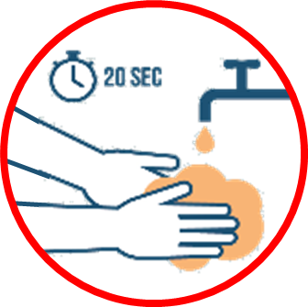
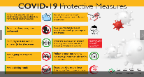
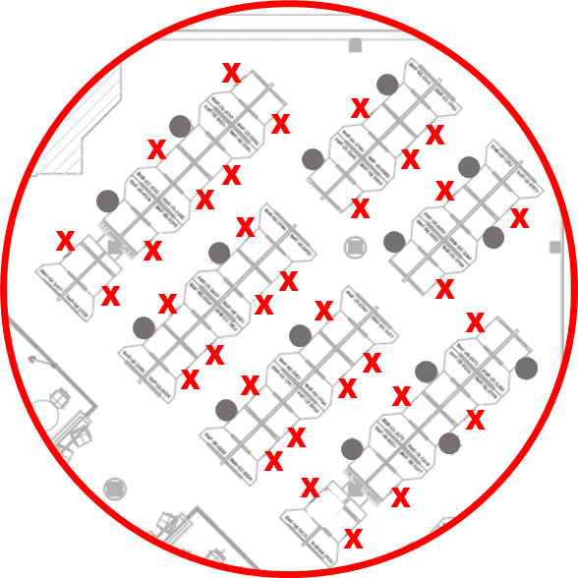
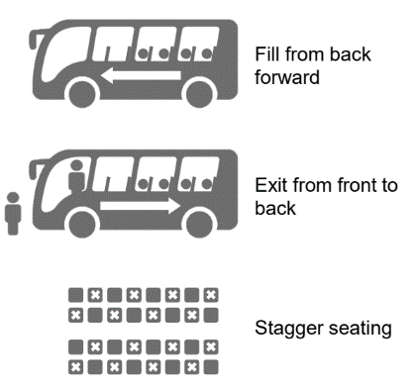
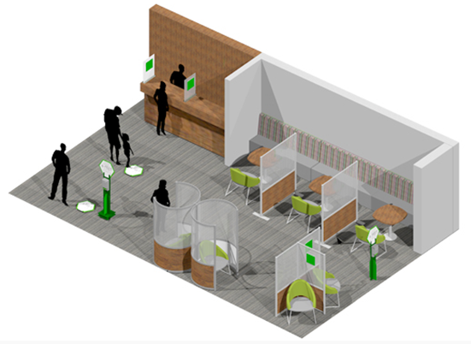
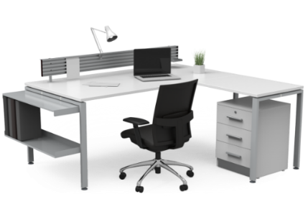
Employee
Assistance
Programme
Testing
Avoid
Crowd
>5 people
&
Tracing
Mandate COVID-19
Staggered Seating
Desks
Hand
Sanitizer
In corridors
Hotline
Protective
Thermal
اعتلال في الصحة النفسية
24441999
Scanner
Max 1
PSYCHOLOGICAL
MAF
24671333
24677439
Measures
Job
need
ISSUES
Clinic
North: 91409386
South: 91408162
ENTRANCE
MY
WORKSPACE
Mandatory
Induction
COVID
Car
MY
COMMUNITY
I will
will
MY TEAM
will
I will
MY
HYGIENE & PPE
I will
MY HEALTH

MY SOCIAL
DISTANCING
will
Self
Assessment
My
COVID
Office
Guide
will
I will
Poster
Awareness Campaigns
صعوبة في التنفس
السعال
الحمى
I will
will
BREATHING DIFFICULTY
COUGH
FEVER
I will
Close
Restaurants
will
Remote
First
Designate
Rooms
Wipe Desk @ Entry &
Exit
Interior
Closed
Packed
COFFEE
SHOP
Lunch
Clear
Desk of
Documents & Books
COVID-19
Disinfect
& Clean
know my
COVID-19
Focal Point
Symptoms
Lunch
Avoid
bringing
Personal items
Home
Avoid Contact
with Livestock/animals
Label
Room Capacity
Social
Distance

Slide 3
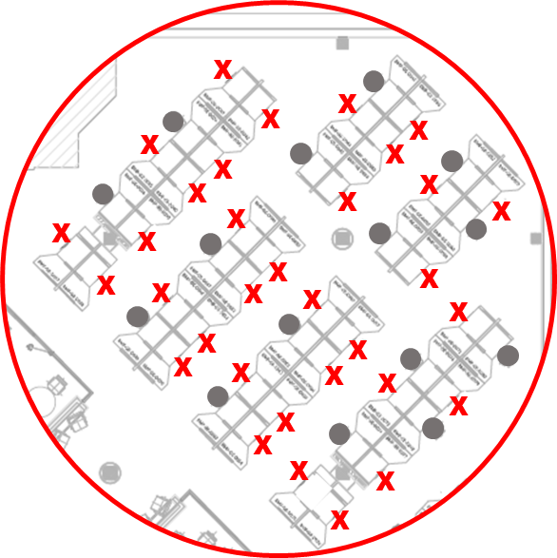
Employee
Assistance
Programme
11
Testing
10
18
Avoid
Crowd
>5 people
13
&
19
17
Tracing
23
22
27
6
Mandate COVID-19
9
15
16
Staggered Seating
Desks
12
Hand
Sanitizer
corridors
26
Hotline
Thermal Scanner
21
24441999
Protective
30
اعتلال في الصحة النفسية
MAF
24671333
24677439
Measures
8
Job
need
≤ 2
PSYCHOLOGICAL
5
14
25
ISSUES
Clinic
20
North: 91409386
South: 91408162
ENTRANCE
MY
WORKSPACE
Mandatory
Induction
COVID
7
Car
MY
COMMUNITY
24
I will
will
MY TEAM
will
I will
4
3
2
MY
HYGIENE & PPE
29
31
I will
MY HEALTH
MY SOCIAL
DISTANCING
1
will

28
Daily
Self
Assessment
My
COVID
Office
Guide
will
I will
صعوبة في التنفس
السعال
الحمى
I will
will
BREATHING DIFFICULTY
COUGH
FEVER
I will
Close
Restaurants
will
Remote
First
50
Designate
Rooms
53
Interior
Closed
32
Wipe Desk @ Entry &
Exit
35
Packed
COFFEE
SHOP
Lunch
51
52
Clear
Desk of
Documents & Books
33
44
49
COVID-19
37
know my
COVID-19
Focal Point
34
Symptoms
>5
45
41
39
Disinfect
& Clean
36
47
Lunch
Avoid
bringing
Personal items
Home
46
43
40
38
48
42
Avoid Contact
with Livestock/animals
≤ 5

Slide 4
1. I will do the short daily self assessment every morning using the app link.
2. If I have fever I will Connect with PDO MAF Clinic at 24671333/24677439 Or North: 91409386, South: 91408162 Or call your local MOH health center Or Ministry of Health hotline 24441999.
3. If I have cough I will connect with PDO MAF Clinic at 24671333/24677439 Or North: 91409386, South: 91408162 Or call your local MOH health center Or Ministry of Health hotline 24441999.
4. If I have breathing difficulty, I will Connect with PDO MAF Clinic at 24671333/24677439 Or North: 91409386, South: 91408162 Or call your local MOH health center Or Ministry of Health hotline 24441999.
5. Key contact numbers.
6. If I face psychological issues, I will contact the PDO clinic on 24671333/24677439.
20. PDO will make available appropriate PPE per job requirements.
21. PDO will make sanitizers available at all corridors and near lifts and staircases.
22. PDO’s daily cleaning regime will ensure focus on entrances/exits during peak times and all surfaces shall be wiped with disinfectant regularly.
23. PDO’s professional disinfecting regimes during the day & in high traffic/shared breakout areas & on commonly touched surfaces such as door handles & lift controls
24. I will avoid sharing small cars while commuting to work & if I do then will keep social distance & adhere to using face mask
25. I will restrict usage of lift & exercise caution. See details mitigation under lifts/elevators
26. I will maintain 2 meters physical distance at all time & wear facemask if 2 meters distance is not possible.
27. Avoid gathering of more than 5 persons.
7. PDO will mandate COVID-19 online induction before first return (to access link).
8. PDO will protect you by taking temperature through guns at each entrance
9. PDO will protect you by taking thermal scans at specified entrances
10. 11. PDO will make available COVID-19 testing when deemed necessary by clinic
11. PDO through MOH is tracking and tracing any spread through app (Link).
12. PDO will mandate compliance to 10 COVID19 protective measures (Link) & reporting of non-compliance.
13. PDO will ensure Employee Assistance Program for employees facing psychological issues
28. PDO will ensure common areas are marked to enable physical distancing.
29. On buses, PDO will ensure back seats will be filled first & ensure seat staggering to enable social/physical distancing. When disembarking from buses, start front rows moving toward the back.
30. PDO will allocate available each office desk as per the 2m social distance. For further detail please refer to detailed guide.
31. PDO will provide awareness campaigns & packages (video/posters/screen savers, etc.)
14. I will wear the appropriate PPE per job requirements
15. I will cover my sneeze into a tissue or elbow & wash or sanitize my hands immediately afterwards.
16. I will dispose off used tissue in the bins provided.
17. I will avoid shaking hands or hugging.
18. I will wash hands regularly with soap and water or hand sanitizer
19. I will avoid touching my face, eyes & nose.
32. I will practice remote first policy on communications.
33. I will wipe my desk clean on arrival & departure each day.
34. I will know my directorate COVID-19 Focal Point.
35. I will keep my workplace clean & clear of books & documents.
36. I will avoid bringing personal items to the office (e.g. plants etc.).
37. PDO’s daily cleaning regime will ensure focus on entrances/exits during peak times & all surfaces shall be wiped with disinfectant regularly.
38. PDO will continue to provide suitable ergonomic office desk & chairs.

Slide 5
39. I will prioritize my team engagements through virtual meetings.
40. I will limit any necessary face to face team meetings applying social distancing rules.
41. PDO will not permit visitors to enter its offices.
42. PDO will post guidelines @ each meeting room, please comply.
43. PDO will ensure meeting rooms desk arrangements in accordance 2m social distancing separation.
44. If I carry any COVID-19 symptoms, I will not come to the office.
45. I will avoid close contact with anyone with cold or flu-like symptoms.
46. I will avoid unprotected contact with livestock, wild & farm animals
47. I will try to bring my own pack meals from home & avoid meals sharing with colleagues, (recommended cold lunches to avoid heating requirement)
48. Costa, Second Cup coffee shops & Subway will be available at MaF for take away orders only, sitting area will remain closed.
49. Costa, Second Cup coffee shops & Subway will be available at MaF for take away orders only, sitting area will remain closed.
50. PDO will continue to make packed lunch available for Interior location staff.
51. PDO will keep all MAF restaurants/canteens closed, Interior canteen will remain open for pack meals pick up only.
52. PDO will ensure suitable prayer place is available e.g. meeting rooms during lunchtime while staff are expected to bring their own prayer mats & adhere to social distancing.
53. PDO will keep masjids closed.

